Slide 1


TCAS Marketing
Update October 2018-2020

Slide 2

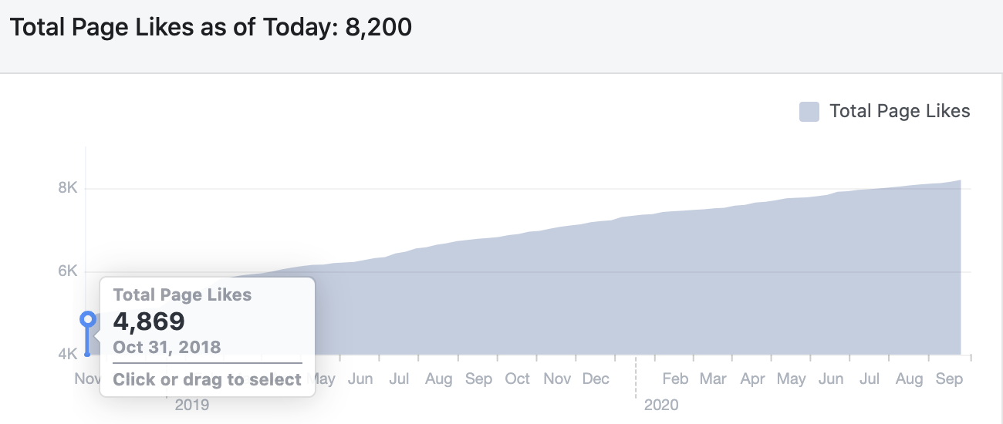
FACEBOOK INSIGHTS
As of 10/23/2018 we had a 351% spike in ‘likes’ on our page since I began a new marketing strategy. This put us at 4,869 Page Likes. As of Today we have 8,200 on the dot. We are currently averaging 2,000 likes a year.

Slide 3
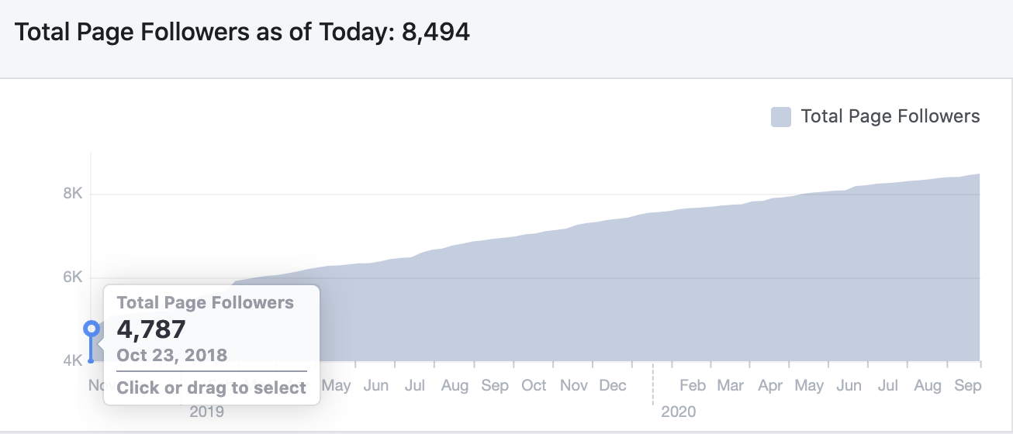
FACEBOOK INSIGHTS
Followers vs. Like. People can follow a page without ”liking” it. We have a total of 8,494 as of today vs. 4,787 in 2018

Slide 4
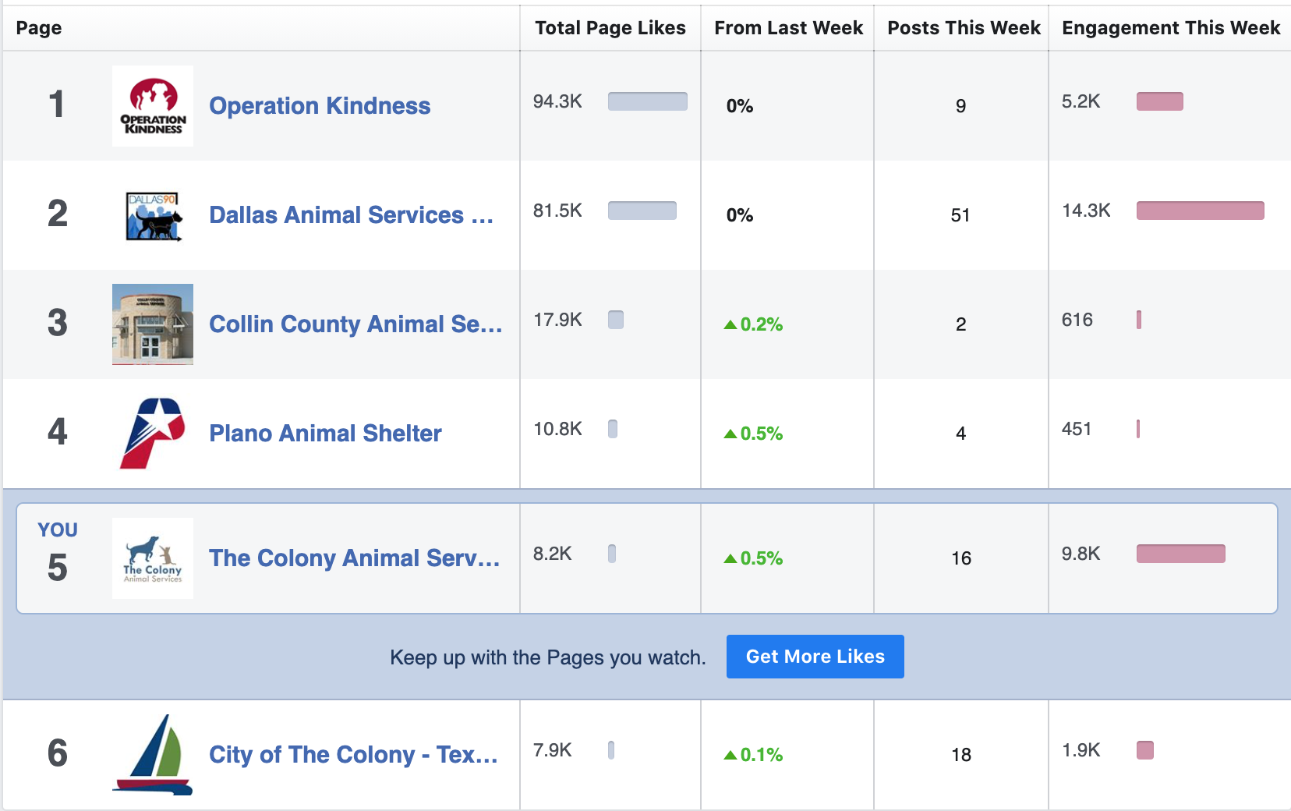
FACEBOOK INSIGHTS
Since 10/23 we have surpassed the city. We used to be about 2,000 like ahead, as of late they are starting to catch our tail. We are now closer to Plano Animal Shelter.

Slide 5

FACEBOOK INSIGHTS - Summary
Great Job! TCAS & PAWS has done a great job collaborating with each other to build an organic audience that truly cares about our shelter. Most the money raised has been from Facebook! This is amazing and the city has noticed. We got this!
GOALS:
Facebook Messenger Policy & Facebook Manners
Grammar
Working Hours

Slide 6
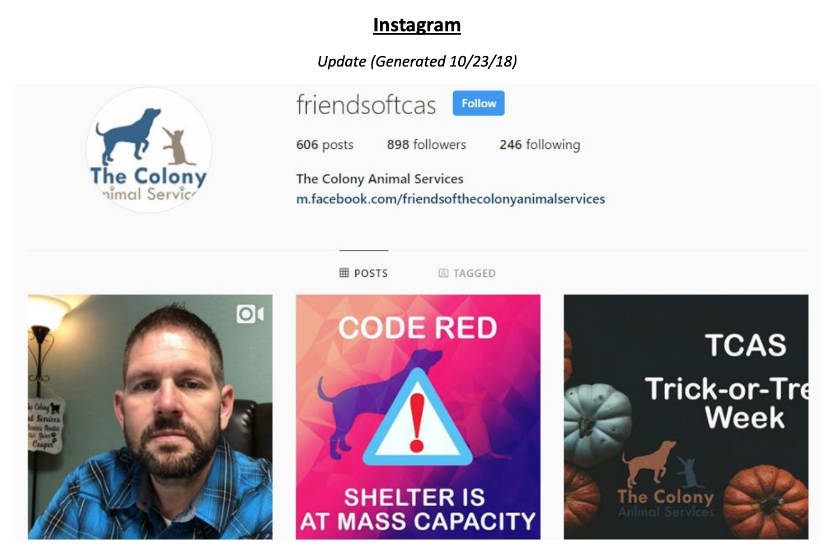
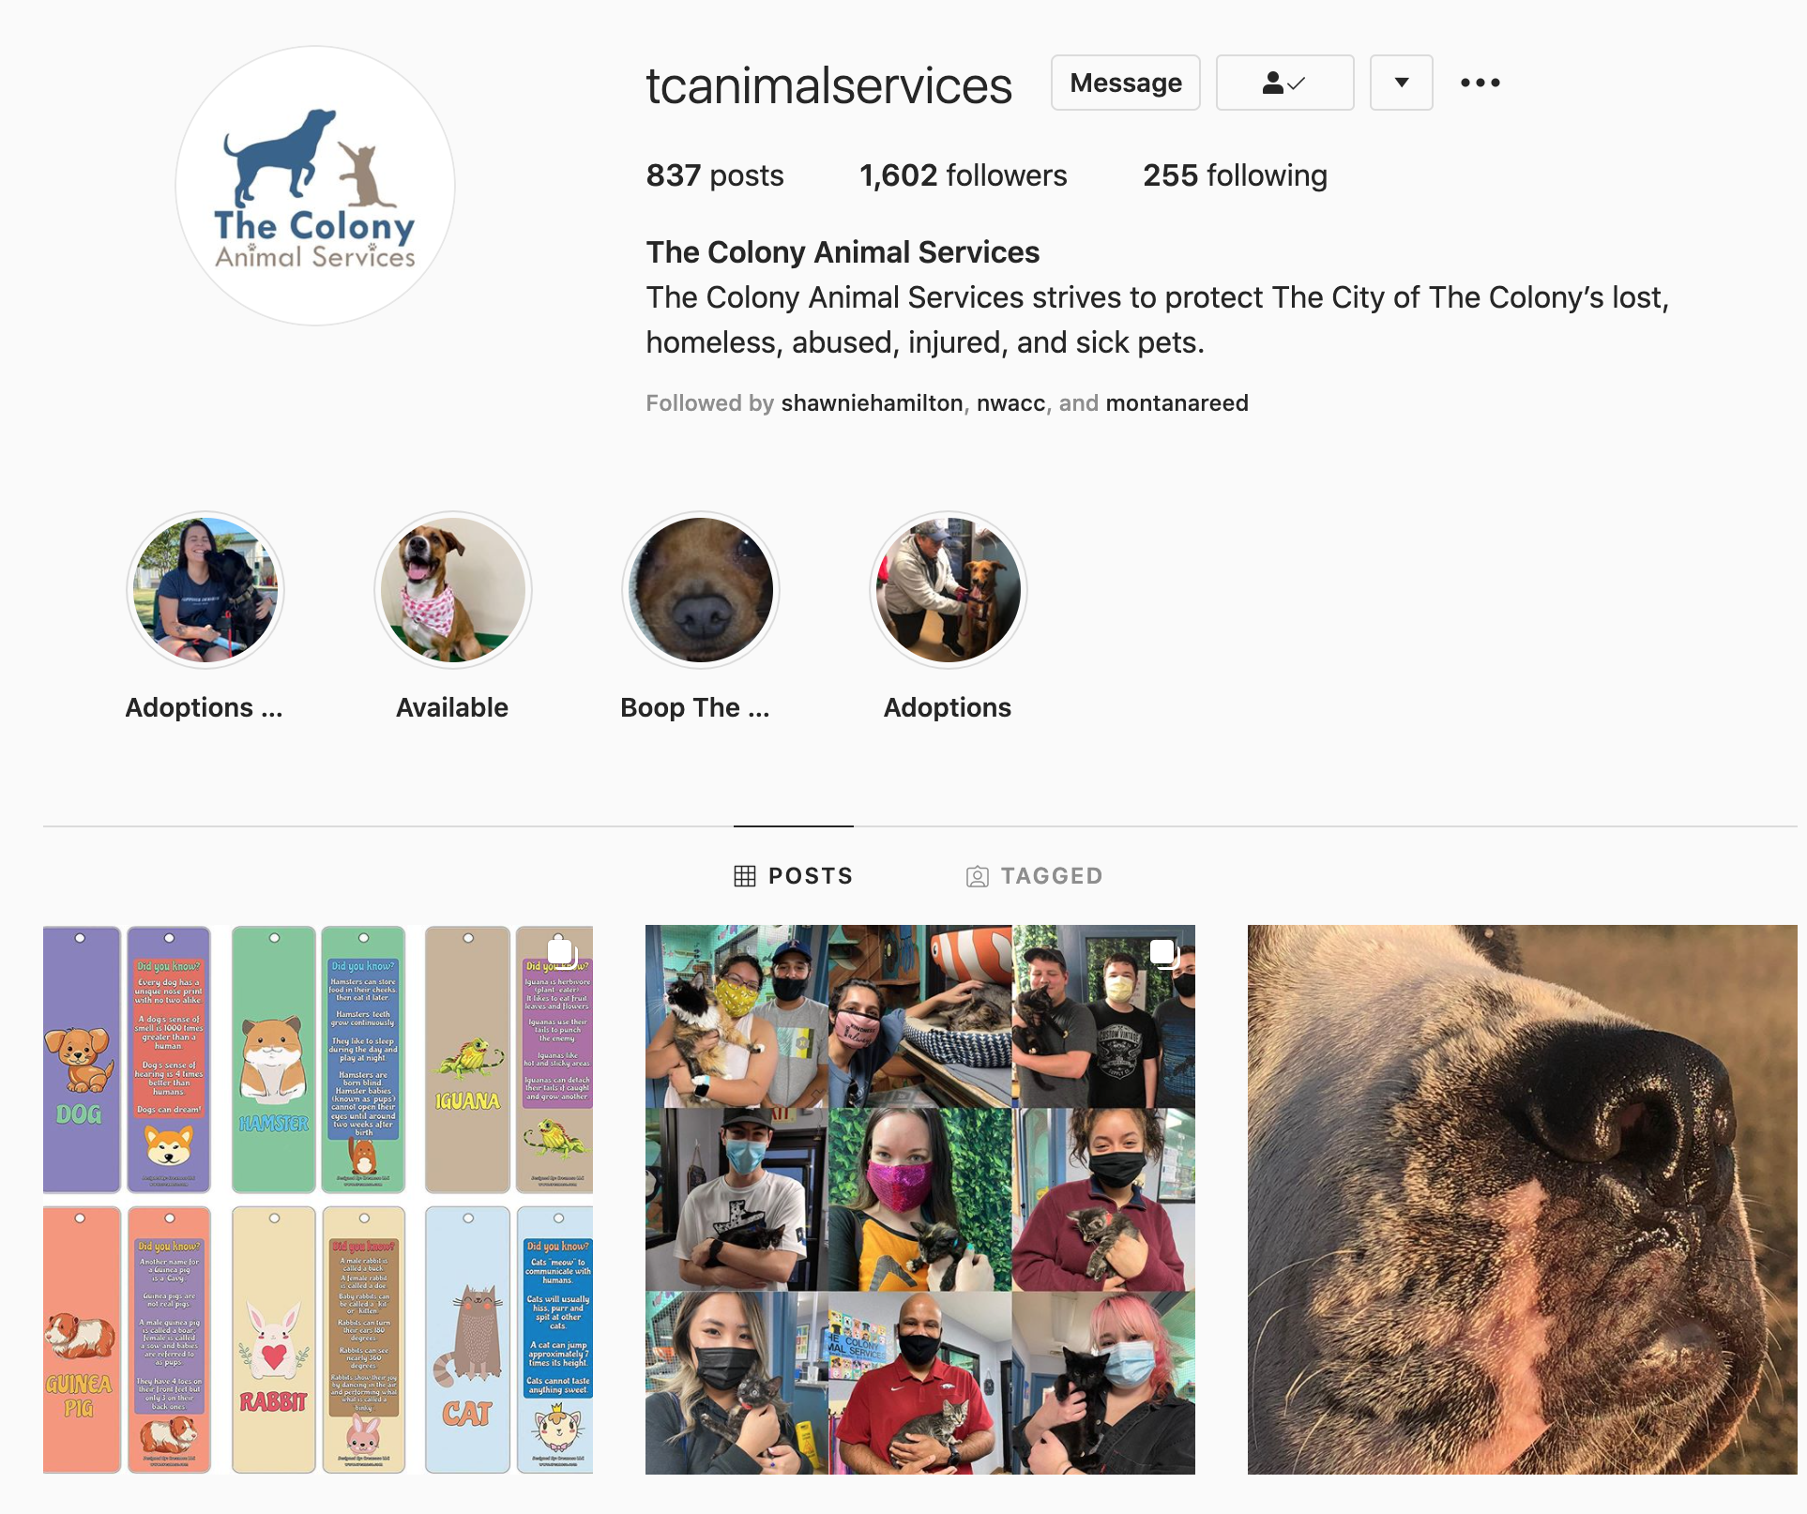
INSTAGRAM by FACEBOOK
898 Followers
1,602 Followers
AS OF 10/23/2018

Slide 7

SNAPCHAT
We are no longer focusing on Snapchat:
Not enough volunteers
Not enough manpower
We will keep our account inactive until further notice.

Slide 8

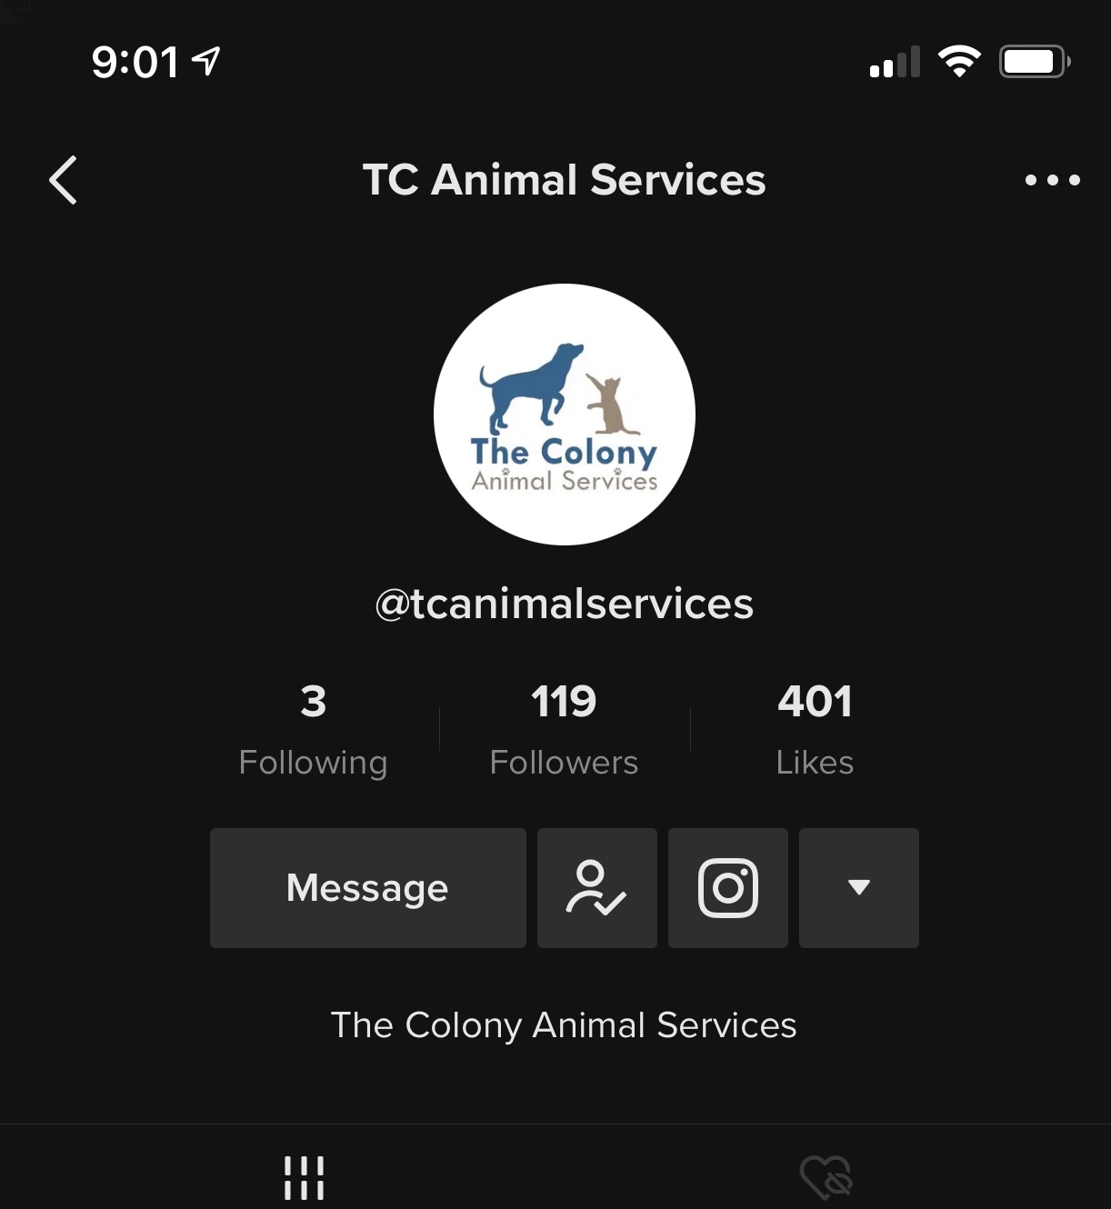
TikTok – YAY! THIS IS DOING GOOD!
We have started TikTok! We are off to a great start! Let's keep this up!
We need to build a strategy that we can execute with TCAS & PAWS Support

Slide 9
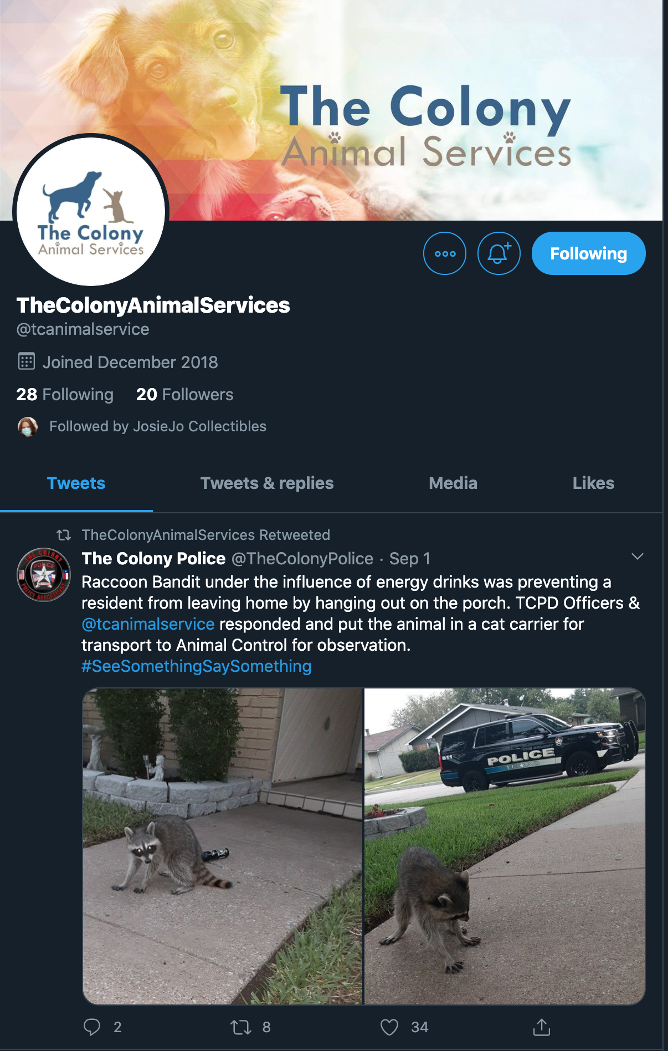
TWITTER
We are running behind on Twitter. We need to make sure what we post on Instagram & Facebook get posted to Twitter

Slide 10
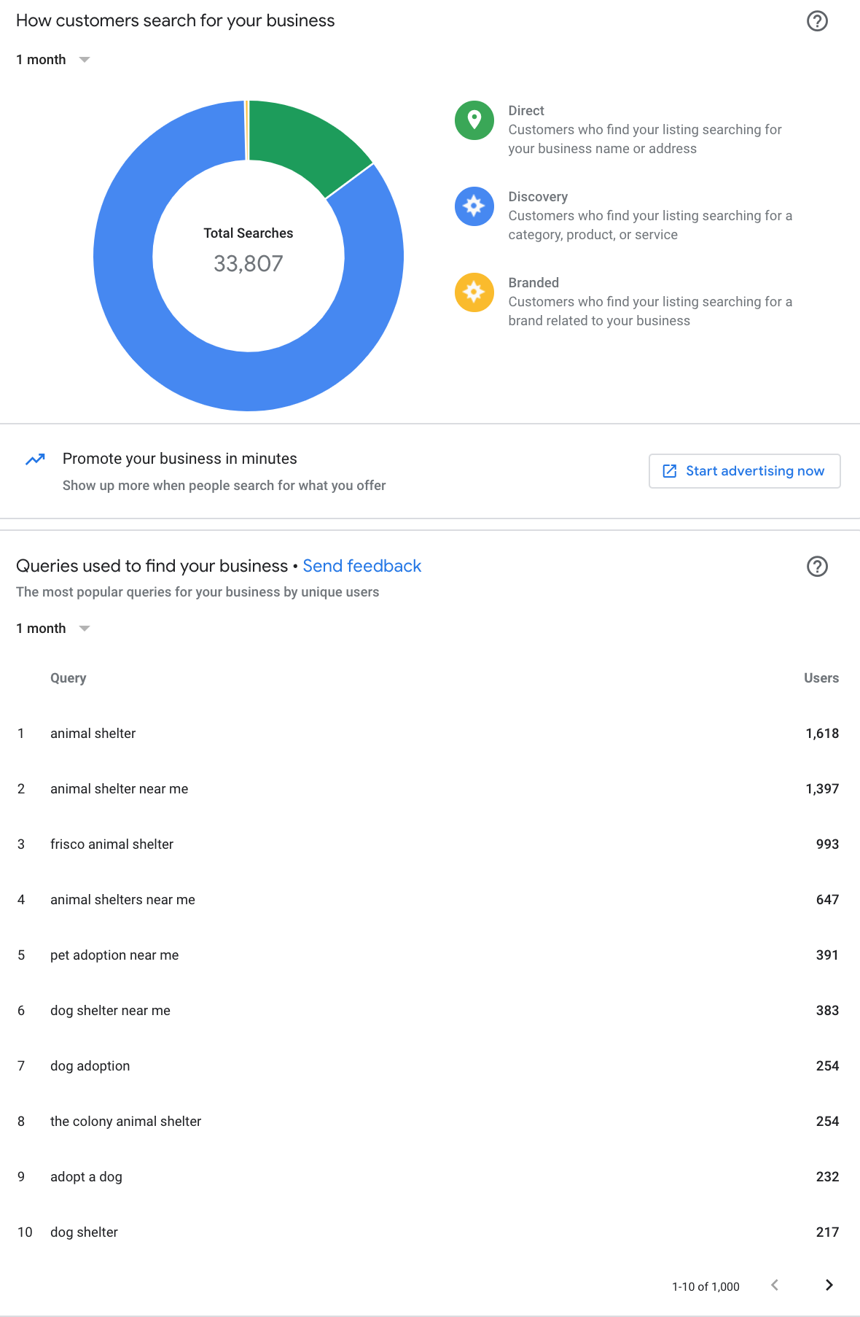
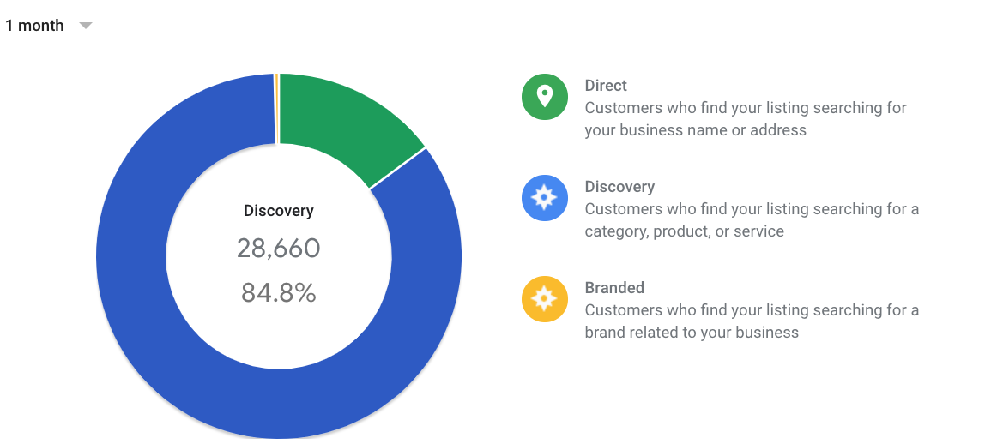
Google My Business - Listing
In one month 33,807 people have searched for TCAS and 500 people called us via Google Searches. We need to use this data to our advantage. With that said I want to introduce WAZE>>>>>>>

Slide 11
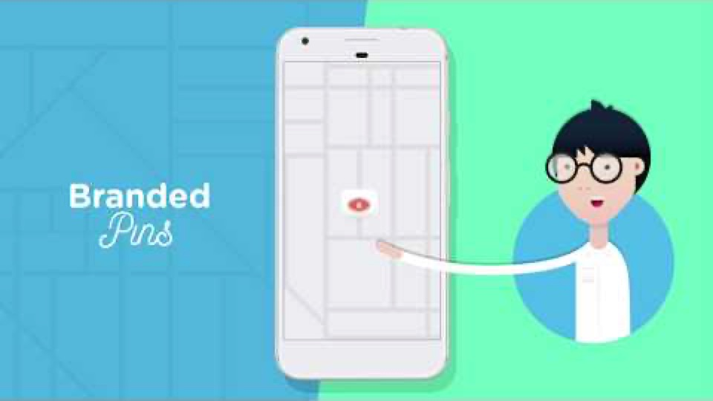
WELCOME TO WAZE

Slide 12
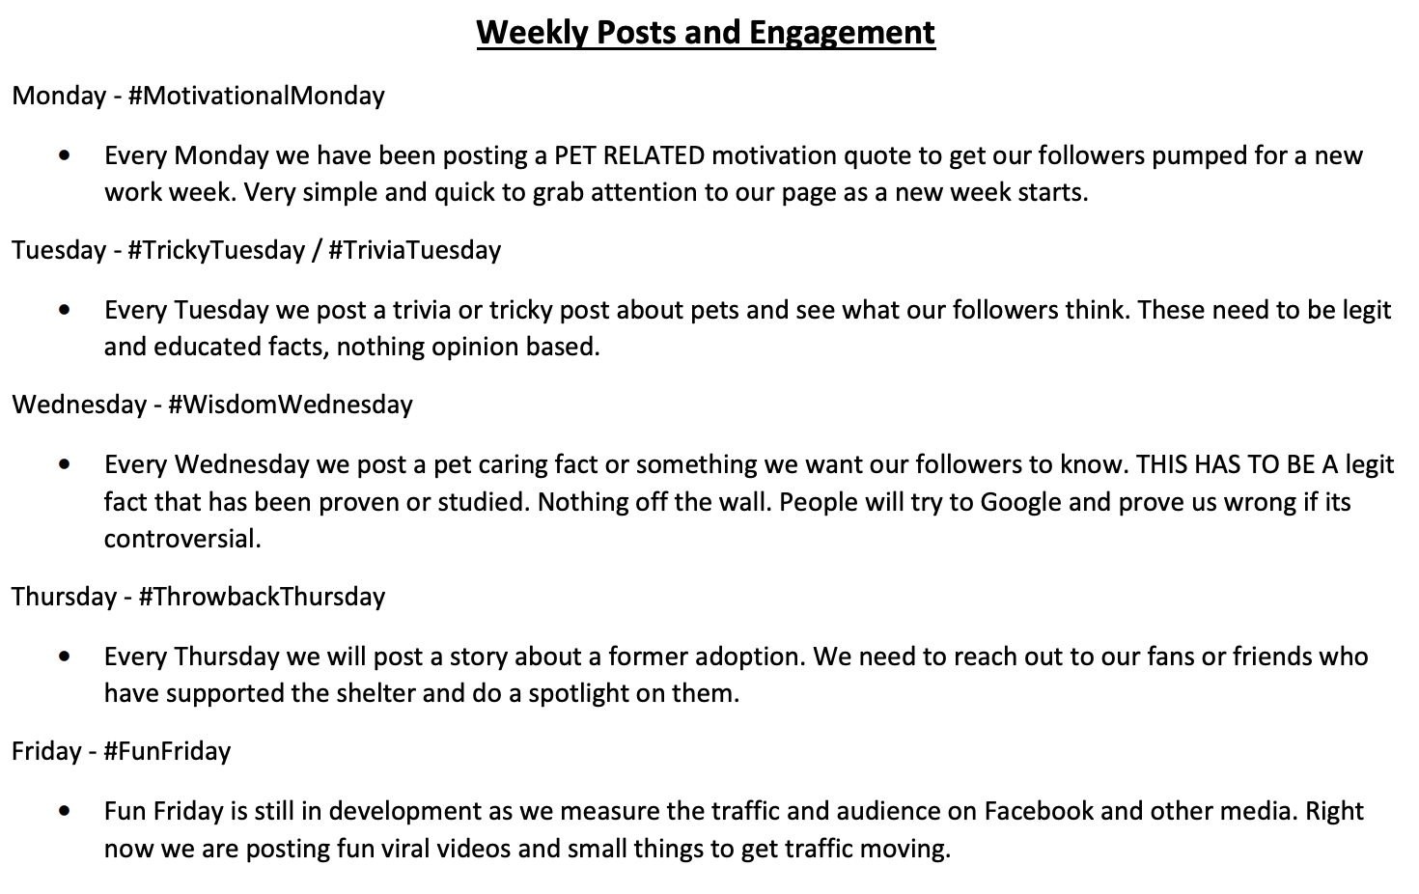
Weekly Post
This is the weekly post plan that we put into place in October 2018. This has changed some over the past two years. There was no set plan like this prior to the marketing makeover.
Currently we have the following:
    Mon. #MansBestFriend
    Tues. #2CuteTuesday
    Wed. #WisdomWednesday
    Thurs. ?????
    Friday. #FelineFriday – Field Trip Friday (NEW)
    Saturday #BootTheScoot
    Sunday: ????

Slide 13
MISC
Branding Guide – Logo | Color Scheme |Font | Tagline
Social Media Policies – Politics | City Policies | Behavior
Social Media Manners – Copyright | Grammar | Posting Times
Quarterly Newsletter from PAWS
New Building > New Branding > New Attitude (out with old in with new)
Virtual Events – Live Sessions | Concert Series |Advice from Staff
Headshots - Board | Lead Volunteers? | Staff
LinkedIn & Pinterest
Community Marketing Outreach
Online Reputation Management – Push Reviews
Movie In The Park – COVID has made this an even bigger thing!
… MAN POWER!

Slide 14
THANK YOU

